Slide 1

Activity Report for 2019

Slide 2
Our Purpose:
To ensure the right of each child diagnosed with an oncological disease to a qualified medical assistance and provide the opportunity for healing and conducting a complete and healthy life;
To promote and defend civil, economic, social, cultural and other legitimate rights and interests of children suffering from oncological diseases;
To contribute to the rehabilitation and integration of children with oncological diseases into the society;
To provide any type of support for children suffering from oncological diseases and for the disadvantaged families taking care of children suffering from oncological diseases who are in the hospital or in homecare;
To raise the awareness of the public on topics of prevention, treatment and services available for the children suffering from oncological diseases.

Slide 3
Our Vision:
Each child diagnosed with an oncological disease, regardless of his or her social background, deserves support and should be offered access to the best possible treatment and medical care. Parents and caregivers of children diagnosed with oncological diseases must have access to all trustworthy information so that they can take informed decisions regarding the treatment of their children.
Families with children suffering from oncological diseases must be involved throughout the entire treatment process: from diagnosis to healing.

Slide 4
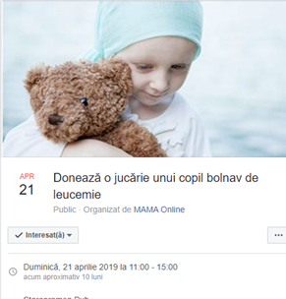
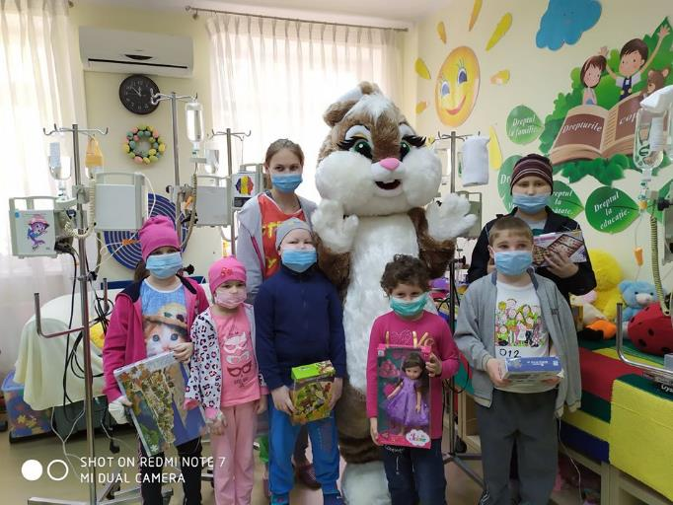
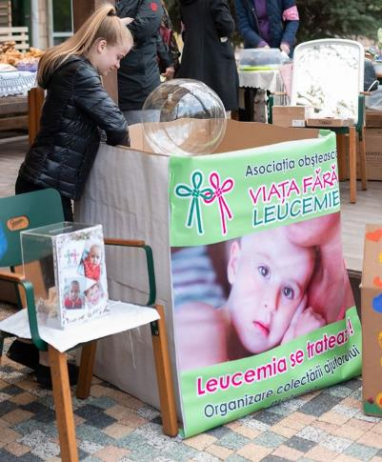
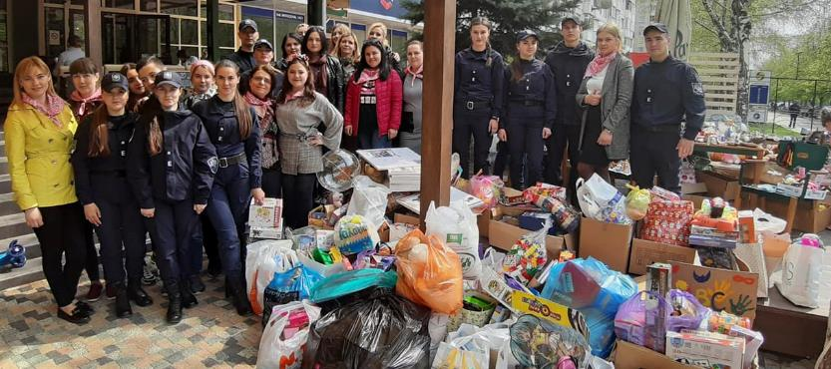
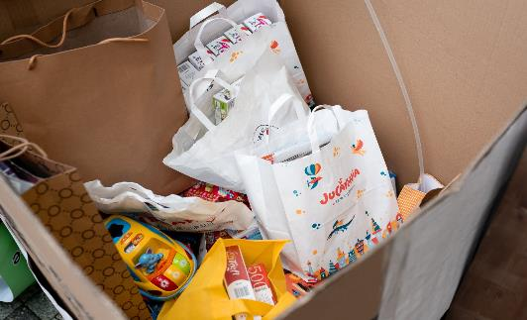
Charity Yard sale „Bucuria Floriilor”
Campaign „Donate a Toy
For a Child Suffering from Leukemia”
We have sold clothing and footwear, jewelry, hand-made items, souvenirs that have been offered to the Association by our supporters; all the collected means have been directed to support the children under treatment in the Onco-pediatric Unit of the Oncological Institute.

Slide 5
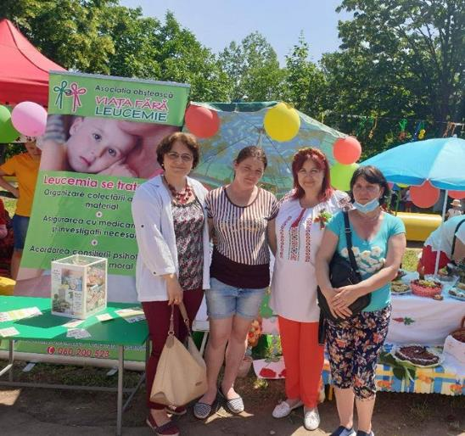
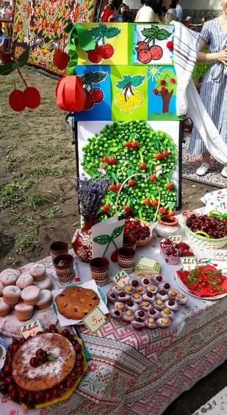
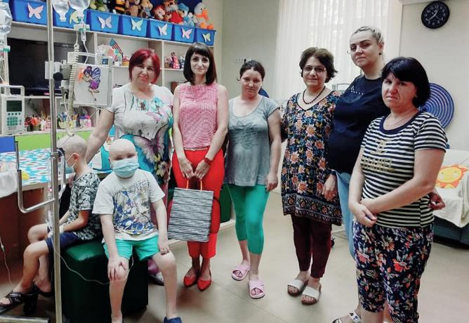
Children Cherry Festival
This festival was organized by the Kindergarten no. 225 from Chisinau. In addition to the fun activities with the participation of children and guests of the festival, this event had also had an important social call - to support two patients of the Pediatric Hematology Unit of the Oncological Institute.

Slide 6
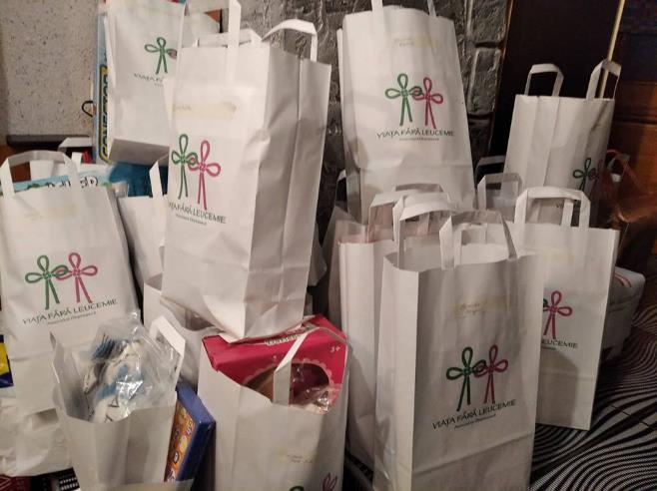
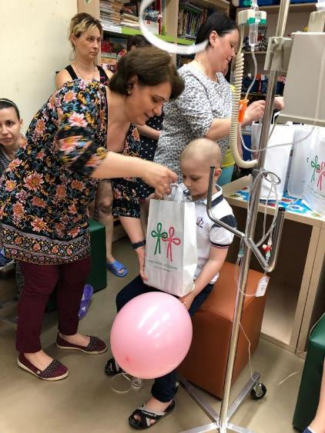
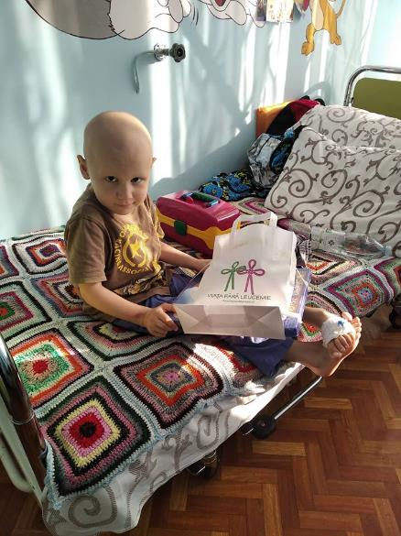
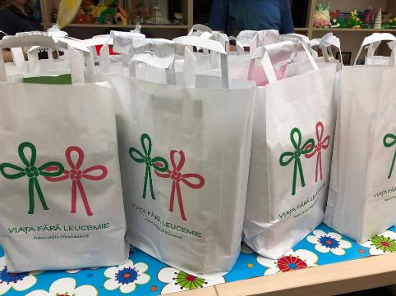
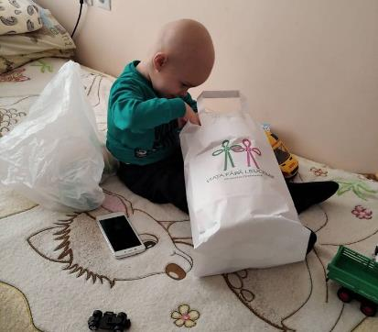
„Purse Surprise”
This is the name for small attentions which the Association shares with the children of the pediatric units of the Oncological Institute. On various occasions, as well as without any, we strive to cheer up the kids with small surprises, to bring smiles on their faces tired of painful procedures and adverse effects of medications that are administered during treatments.

Slide 7
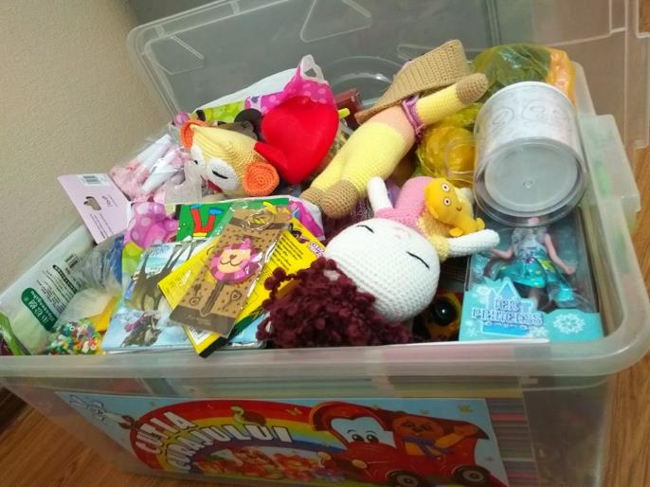
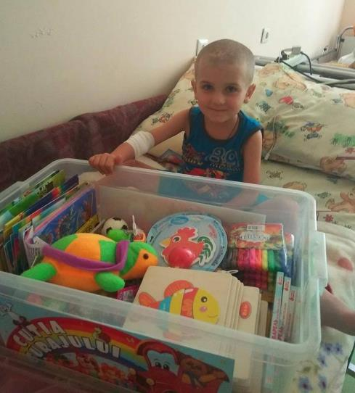
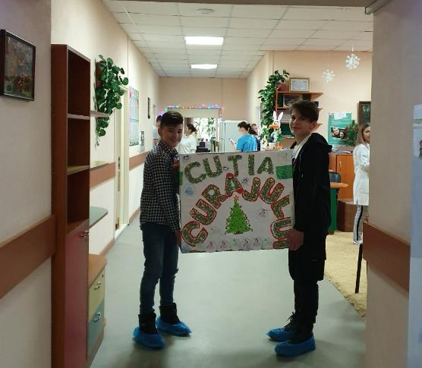
Courage Box
A project aimed to reward the sufferings of children related to painful and unpleasant procedures during medical treatment. Thus, each child can choose from the Courage Box a toy they like that will allow them, at least for a few moments, to forget about pain

Slide 8
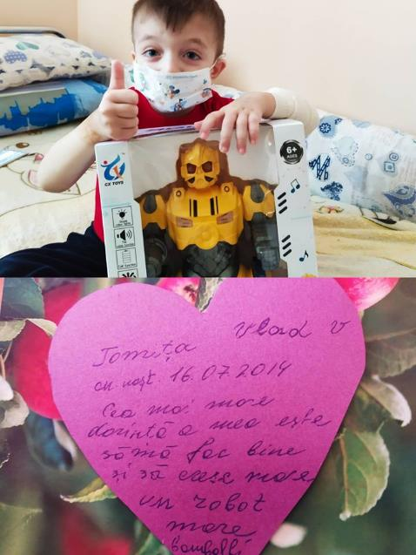
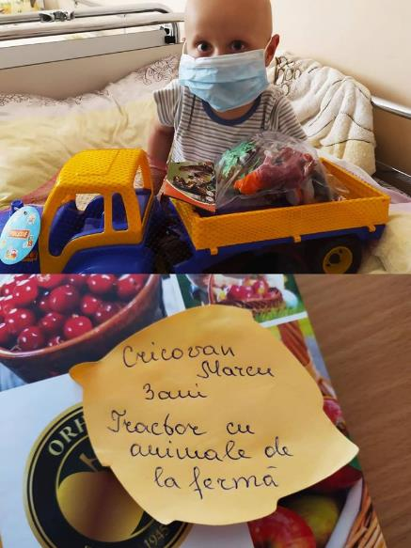
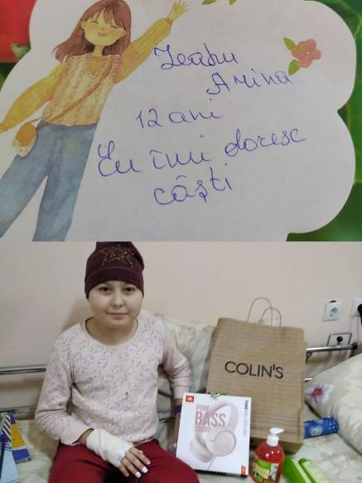
The Meadow of wishes
A project aimed for the newly diagnosed patients of the Pediatric Hematology Unit of the Oncological Institute that allows them to reduce the stress after the hospitalization.
We share the wishes through social media and our volunteers and supporters take care that they come true!

Slide 9
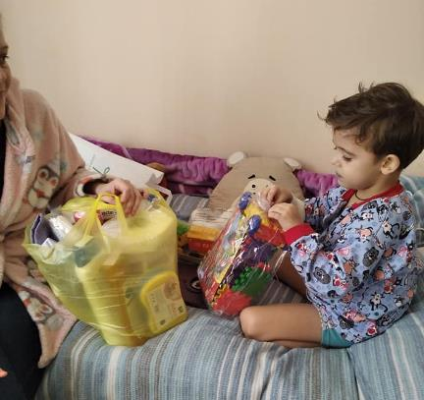
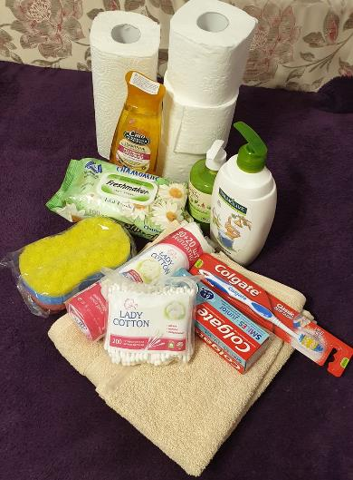
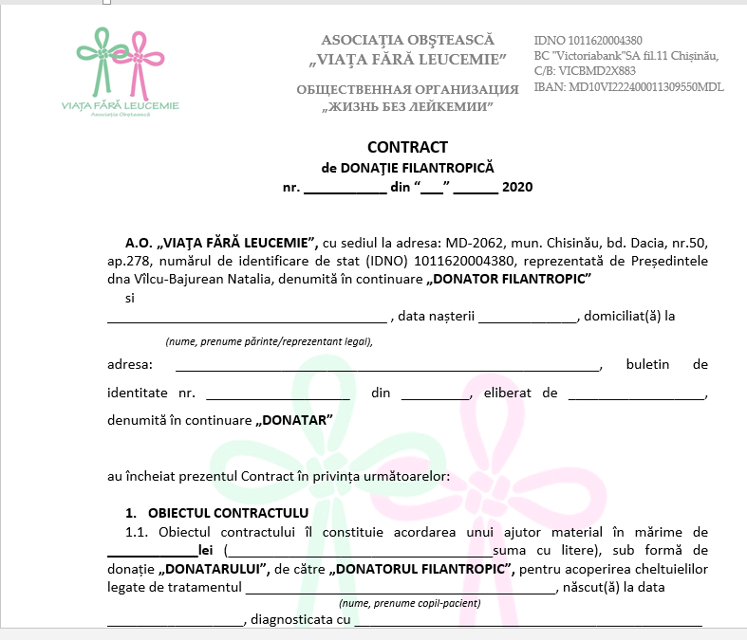
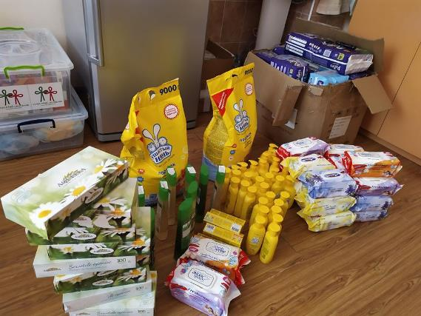
Assistance on admission and stay in the hospital
Through our programs aimed to provide social support to the families of children suffering from onco-hematological diseases, admitted in the Pediatric Hematology Unit of the Oncological Institute, in 2019 we provided assistance to 19 families (financial aid, sanitation, clothing, etc.).

Slide 10
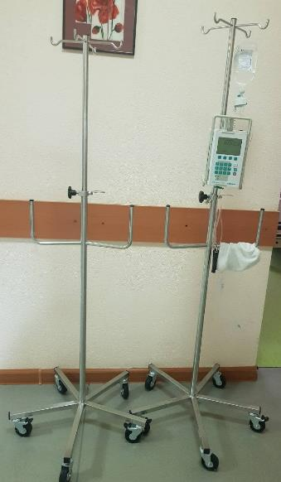
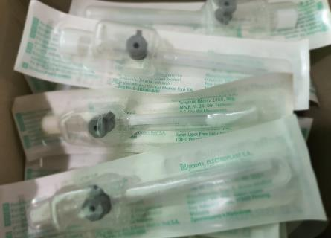
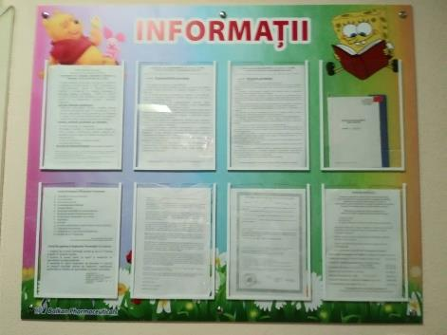

Supporting the Pediatric Hematology Unit of the Oncological Institute
In 2019 the Association offered support to purchase 3 Braunostates (stands for BBraun Infusomate), perfusor tubing lines (1800 pcs), Vazovix Branula (4000 pcs), Syringes for syringomats (660 pcs), lumbar needles (550 pcs)., a multifunctional printing devise.
The Unit is being weekly provided with about 100 liters of drinking water which is available to patients, parents, as well as medical staff.
A new panel has been fixed in the Unit to help share the most important information for patients and parents

Slide 11
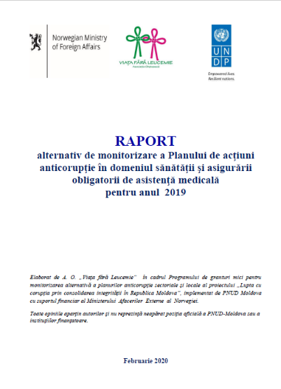
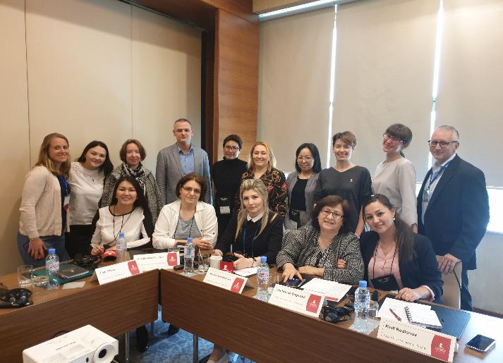
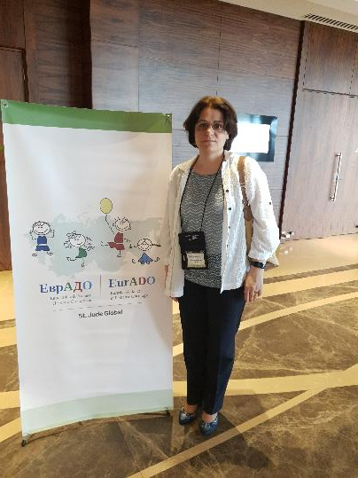
International cooperation
Participation in UNDP – Moldova Project
Participation in the Eurasian Alliance in Pediatric Oncology (EurADO)

Slide 12
Financial Results
Total financial means accumulated on the account of the Association from individuals and legal persons – 421,468.70 lei, plus non-financial support – 13,300.00 lei;
Financial means directed to support the families of children with oncological diseases - 167,645.71 lei;
Financial means directed to support the activity of the Pediatric Hematology Unit – 134,106.03 lei;
Educational and entertaining activities for children admitted in the Pediatric Units of the Oncological Institute – 10,094 lei;
Administrative expenses for the maintenance of the Association – 19,113.4 lei;
Budget within the UNDP Moldova Program – 238,163.91 lei.

Slide 13
Perspectives for 2020
Continuing the implementation of our projects "Courage Box", "Meadow of Wishes", "Purse Surprise";
The Second edition of the campaign „Donate a Toy For a Child Suffering from Leukemia” ediția II;
Fundraising activities:
letters to the business environment from the Republic of Moldova to encourage sponsorship, on the occasion of the International Childhood Cancer Day (February 15);
encouraging the use of 2% mechanism (between March and April 2020) in the social media and through the dissemination of leaflets;
organizing fundraising events;
Organization of educational and entertainment activities for children admitted to the pediatric units of the Oncological Institute (concerts, theatrical performances, master-classes, etc.);
Organization of recreational activities for parents of admitted children;
Publication of informative materials on subjects related to taking care of children suffering from oncological diseases;
Creation of the website www.viatafaraleucemie.md;
other activities aimed to achieve the purposes of the Association.

Slide 14


